Slide 1

[Samsung PRISM] Mid Review Report
[ Realistic Rendering of Hands ]
Team
Realistic Rendering of Hands
KLE Tech Mentors: Ramesh Ashok Tabib, Uma Mudenagudi
Samsung Mentors: Lokesh Boregowda, B H Pawan Prasad
Students:
Chakit Bhandari (01FE19BEC037)
Aniket Jog (01FE19BCS085)
Sumant Kurse (01FE19BEC255)
Department/ School: School of Electronics and Communication Engineering
School of Computer Science and Engineering
Date: 15 Feb 2022

Slide 2



Work-let Area – AI, ML | Realistic Rendering of Hands
TM
[ Problem Statement ]
[ Expectations/KPI ]
3
4
Introduction:
Annotating large datasets occasionally proves a hurdle for training Deep Neural Networks. Synthetic data comes handy in such cases making it possible to generate a large volume and variety of data that comes pre-annotated, especially in 3D hand pose estimation. While using synthetic data has been reported to increase accuracy for some tasks, the lack of realism in a pure synthetic data makes it inadequate for others (especially when data is in colour/RGB domain).
Project Goal:
The goal is to investigate the role of synthetic data in 3d hand pose estimation (HPE) in third-person point of view. Specifically, we explore the rendering choices that make the synthetic hands look realistic, and their effect HPE generalization to real-data. To this end, we create a corpus of synthetic data set by varying the hand shapes, poses, skin colours, textures, illumination, background etc. [1, 4, 5]. The canonical hand poses are modelled after commonly used real-life hand movements [2]. Hand poses are geometrically constrained to humanly plausible articulations [3]. Annotations include 3D joint locations, segmentation masks and others [6]. To assess the merit of the dataset, we employ an existing 3D HPE [5]. We perform detailed ablation study to find the optimal rendering configuration to improve the HPE accuracy when trained on purely synthetic data and tested on real-world 3D hand pose data.
Members
Months
Programmatically create a dataset of 100k synthetic RGB hand images in various plausible poses, textures and lighting conditions
Train an existing 3D hand pose network achieve good generalization on real-world data
> 85% AUC on STB dataset
Ablation study to identify the key rendering choices for generalization
[ Trainings / Pre-requisites ]
Good knowledge in computer graphics and rendering
Good understanding of linear algebra
Hands-on Tensorflow/Keras/Pytorch
[1] https://www.blender.org/
[2] Jarque-Bou, et al. "A large calibrated database of hand movements and grasps kinematics." Scientific Data 7.1 (2020): 1-10.
[3] Zhang, Xiong, et al. "End-to-end hand mesh recovery from a monocular rgb image." ICCV. 2019.
[4] Ge, Liuhao, et al. "3d hand shape and pose estimation from a single rgb image." ICCV 2019.
[5] Zimmermann, Christian, et al. "Learning to estimate 3d hand pose from single rgb images." ICCV 2017.
[6] Lin, Fanqing, Connor Wilhelm, and Tony Martinez. "Two-hand Global 3D Pose Estimation Using Monocular RGB." arXiv preprint arXiv:2006.01320 (github).
[7] Aristidou, Andreas. "Hand tracking with physiological constraints.“ 2018
[ Timeline ]
Survey report
Data aggregation
Report baseline metrics
Improvements in arch.
Report improvements
Final data & code
Kick Off <1st Month>
Milestone 1: 2nd Month
Milestone 2: 3rd Month
Closure: 4th Month
Setup Blender, hand models
Understand NinaPro DB9 dataset
Generate initial set of synthetic samples
Implement hand pose constraints
Synthetic data preparation
Train an off-the-shelf 3D HPE.
Perform ablation study by varying rendering configuration
Refine algorithms
Benchmark results
[Mentors]
Sandeep Jana
sandeep.jana@samsung.com
Rajas Joshi
rajas.joshi@samsung.com

Slide 3
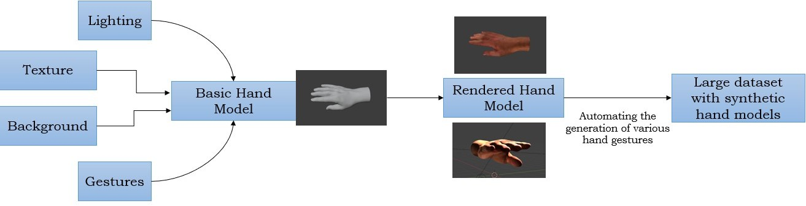
Proposed Approach / Solution
Concept Diagram :

Slide 4
Dataset(s) Analysis / Description
Dataset Capture / Preparation / Generation :
The source code of libhands was modified in order to automate the process of generation of various hand gestures.
The raw images saved were converted to RGBA format and background was added to those converted images.
Dataset Understanding / Analysis :
A hand-joint tracking algorithm was applied on the generated synthetic images to identify the hand-joints.
The algorithm was successfully able to capture all the hand-joints and render it on the screen.
Dataset Pre-Processing / Related Challenges (if any) :
The primary challenge was to modify the source code in order to save the hand gestures based on the code injected.

Slide 5
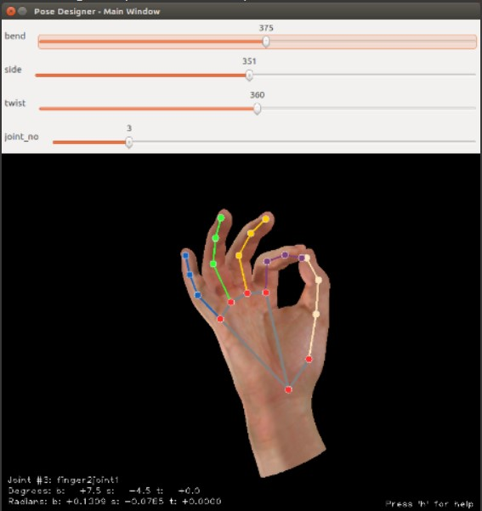
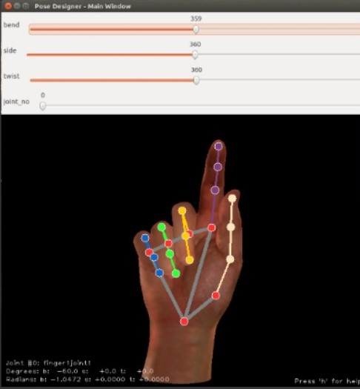
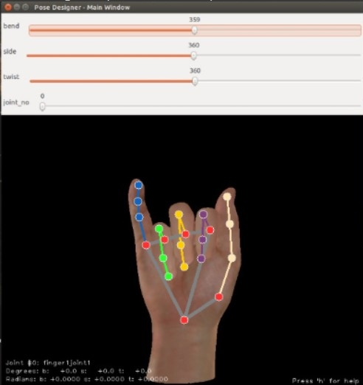
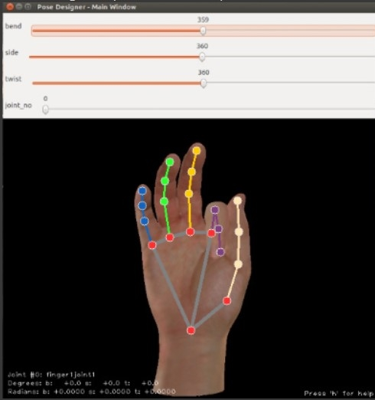
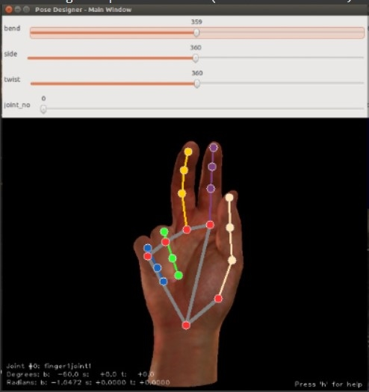
Experimental Results / Simulations / Observations
Results : Hand-joint Tracking

Slide 6
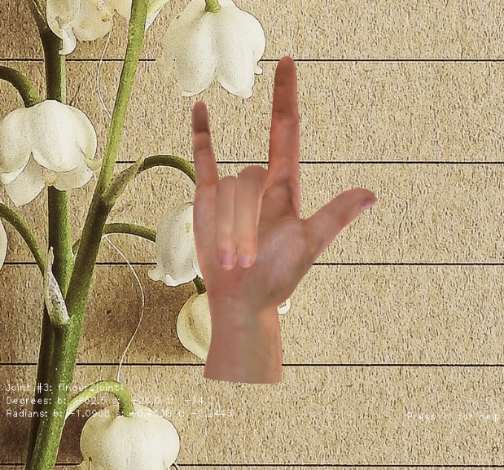
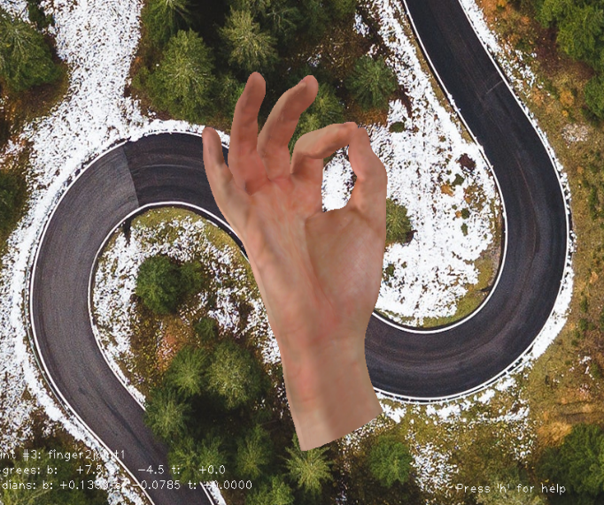
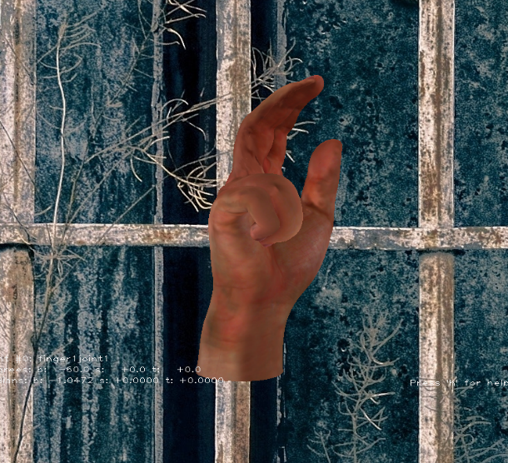
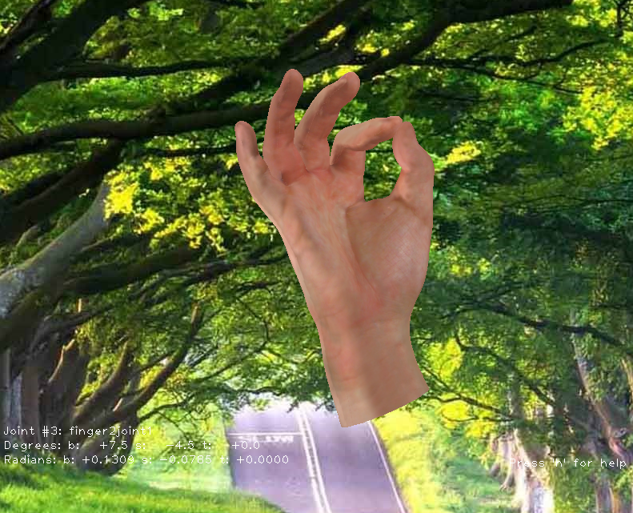

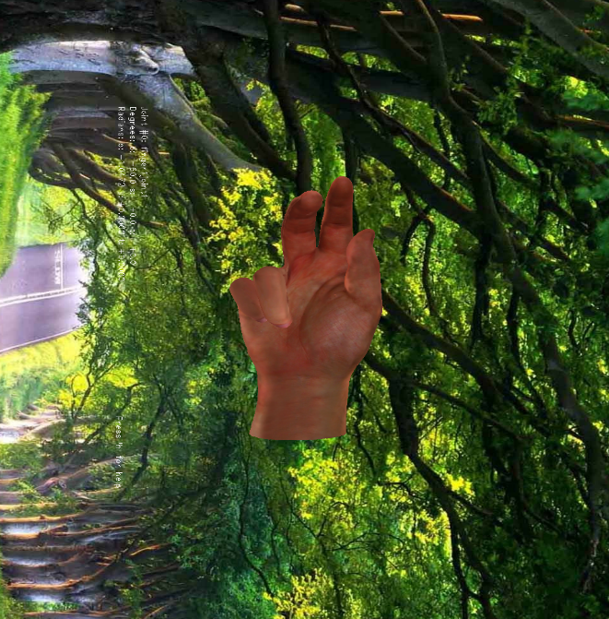
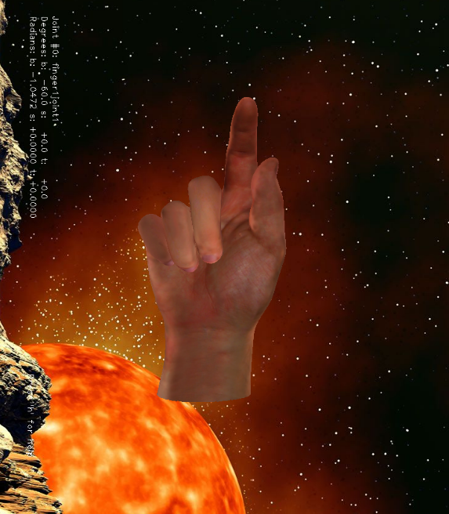
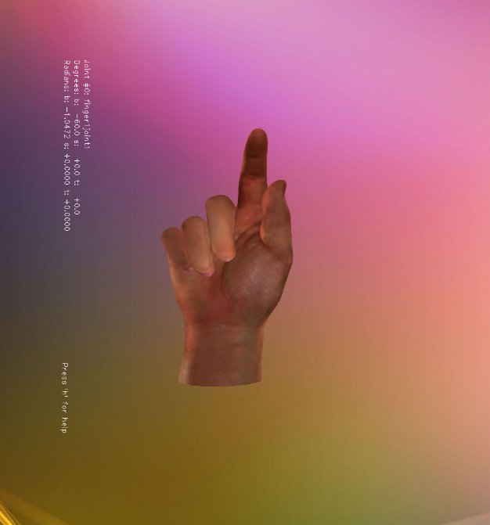
Experimental Results / Simulations / Observations
Results : Generated Images

Slide 7
Experimental Results / Simulations / Observations
Major Observations / Conclusions & Challenges :
As libhands in itself is not a complete hand rendering software, so in order to add the backgrounds, OpenCV library had to be used which increased the time complexity.
The primary challenge was to modify the source code in order to save the hand gestures based on the code injected.

Slide 8
Further Plan to Complete Project
Final Probable Deliverables :
Provide global lighting, along with various backgrounds.
Training on the synthetic data ,testing the accuracy of the model.

Slide 9
Further Plan to Complete Project
Completion Plan:
Week 1 to 2
Step 1 Fully automating the libhands software.
Week 2 to 4
Step 1 Training on the synthetic data.
Week 5 to 6
Week 7 to 8
Step 1 To identify the key rendering choices for generalization
Step 2 Testing the accuracy of the model.
Step 2 Providing global lighting, along with various backgrounds.
Step 1 Reviewing the results obtained and making the model more robust.
Challenges Anticipated:
Getting AUC > 85% on STB dataset
Git Upload details:
https://github.ecodesamsung.com/SRIB-PRISM/KLE_VR16KLE_2_Realistic_Rendering_Hands

Slide 10
Thank you

